Slide 1

The impact of the media as a stakeholder in the UK Healthcare service delivery: Impact of the media on different perspectives (Global, National and Local). Week 7-(B)

Slide 2
Aim:
To explore how Covid 19 can be implemented to achieve appropriate results yet minimises disruptions to healthcare services provision
Learning Outcomes:
At the end of this session , students will be able to:
Explore the impact of the media as a stakeholder in Healthcare service delivery
Impact of the media on different perspectives

Slide 3
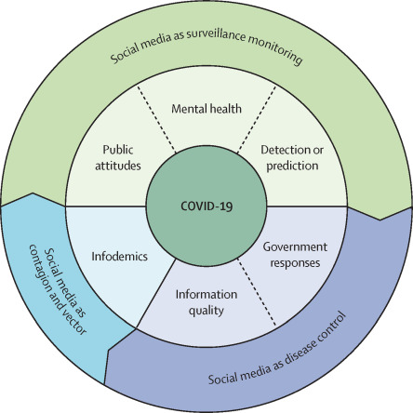
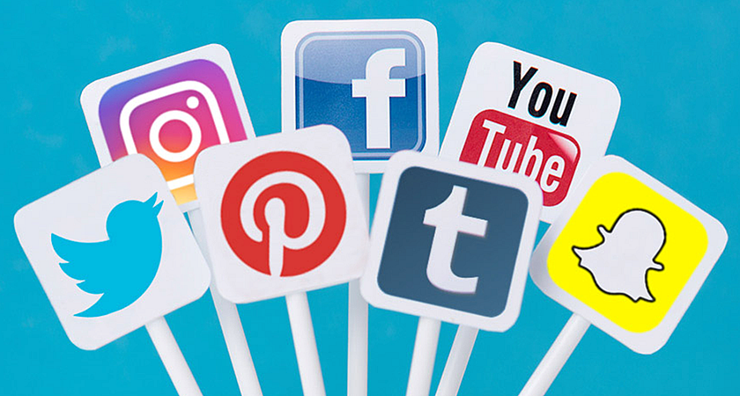

Slide 4
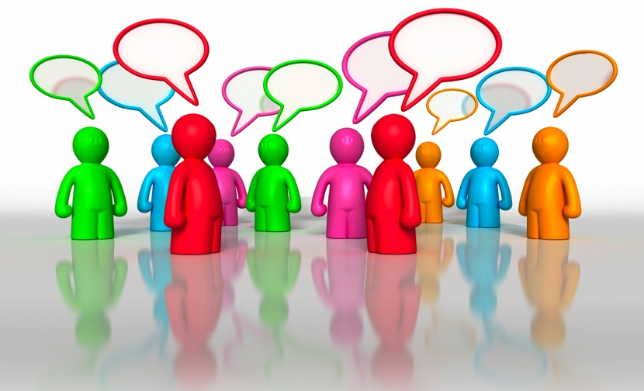
Public attitudes
Studies on social media data showed our attitudes and mental state to some extent during the COVID-19 crisis.
These studies also showed how we generated, consumed, and propagated information on social media platforms when facing the rapid spread of the SARS-CoV-2 and extraordinary measures for the containment.

Slide 5
Public attitudes (Cont.…)
When a disease, such as COVID-19, starts spreading and causing negative sentiments, timely, proper, and effective risk communication is needed to help ease people's anxiety or negative attitudes regarding the COVID-19 pandemic, especially through social media.
Articles regarding public attitudes towards the COVID-19 pandemic have shown sentiments that shifted over time.
Yet, this theme can be a useful indicator when evaluating interventions, such as physical distancing and wearing masks, that aim to reduce the risk of COVID-19 infection.

Slide 6
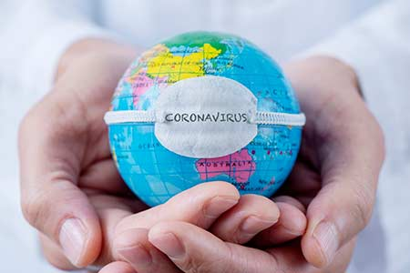
Public attitudes (Cont.…)
Articles regarding public attitudes towards the COVID-19 pandemic have shown sentiments that shifted over time.
Yet, this theme can be a useful indicator when evaluating interventions, such as physical distancing and wearing masks, that aim to reduce the risk of COVID-19 infection.
When a disease, such as COVID-19, starts spreading and causing negative sentiments, timely, proper, and effective risk communication is needed to help ease people's anxiety or negative attitudes regarding the COVID-19 pandemic, especially through social media.

Slide 7
Public attitudes (Cont.…)
Government responses that were distributed via social media have been increasingly crucial in combating infodemics and promoting accurate and reliable information for the public.
However, little has been studied about how efficient and effective these official responses are at leading to public belief or behavioural changes.
It also remained unknown whether government posts would reach greater numbers of social media users or have greater effects on them than would infodemics.

Slide 8
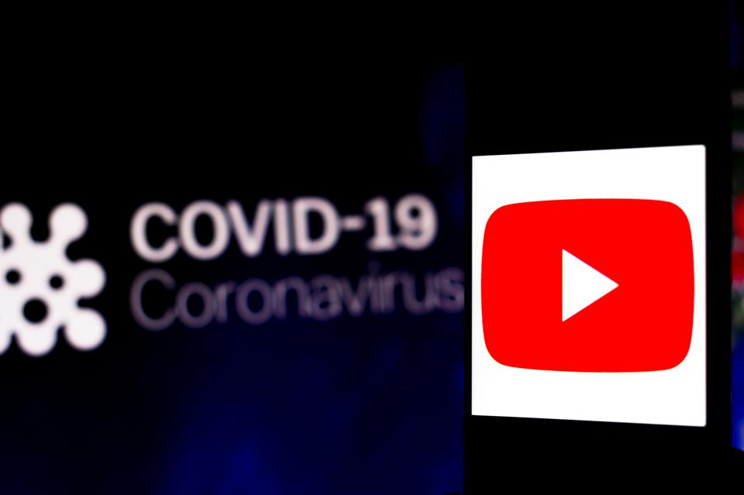
YouTube and the control of COVID-19
YouTube has served as one of the major platforms to spread information concerning the control of COVID-19.
YouTube has served as one of the major platforms to spread information concerning the control of COVID-19.
Therefore, videos, especially from public health authorities, should include accurate and reliable medical and scientific information and use relevant hashtags to reach a large audience, generate a high number of views, and increase responses.

Slide 9
YouTube and the control of COVID-19
Video’s play important role to understand the various health related issues and guide them about the prevention or cure of disease.
Different ways of information related to health and social care present have great influence on thoughts and behavior of people.
High-frequency word clusters, such as death, test, spread, and lockdown denoted the public's underlying fear of infection and death from the COVID-19 virus, whereas terms such as stay home and social distancing corresponded to behavioural shifts.

Slide 10
Cont.…
Most YouTube videos were of undesirable quality because they contained few recommended preventions from governments or public health organisations.
The undesirable quality is a worrisome observation if accurate and reliable videos and other types of information are not created and disseminated in a timely manner.

Slide 11
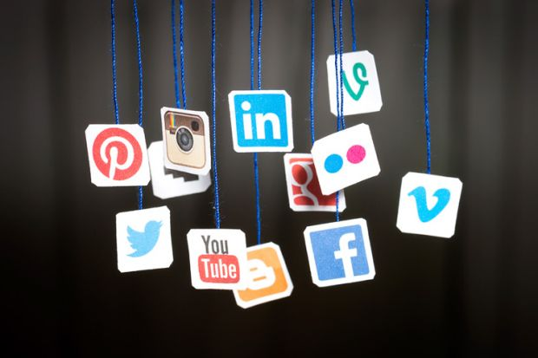
Social media as disease control
Whether COVID-19 is a one-time event or will become seasonal, like influenza, is unknown.
If COVID-19 becomes seasonal, then it might be meaningful and useful to establish a real-time model to monitor the disease by use of social media data.
To inoculate the public against misinformation, public health organisations and governments should create and spread accurate information on social media because social media has had an increasingly important role in policy announcement and health education.

Slide 12
Social media as disease control
The importance of measures for physical distancing and proper hand-hygiene practices to cope with the COVID-19 pandemic.
Studies investigated the quality of YouTube videos with COVID-19 prevention information. (i.e, the number of recommended prevention behaviours that were covered in the videos—eg, wearing a facemask, washing hands, physical distancing, etc).
Four crucial preventive topics is identified regarding Covid 19 on the social media; mask wearing, risk assessments, stay at home order, and disinfectants or sanitisers.

Slide 13
Social media data were useful to detect mental health
Public health measures, such as physical distancing and lockdown, that were implemented in the COVID-19 pandemic aggravated risk factors and adverse health behaviours at the individual and population levels.
Studies showed that social media data were useful to detect mental health issues at the population level. Due to the early outbreak of COVID-19 and the prevalence of social media, reports showed an increase in issues of mental health among the population.
Studies on social media data showed our attitudes and mental state to some extent during the COVID-19 crisis.

Slide 14
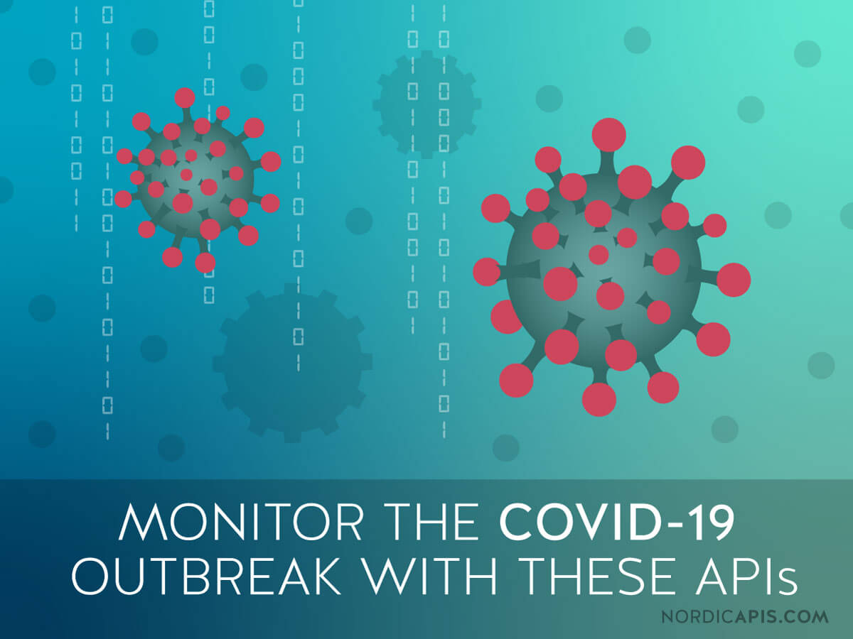
Social media data for monitoring surveillance
In terms of the surveillance of the COVID-19 pandemic, six chosen studies showed methods to detect or predict the number of COVID-19 cases by use of social media data.
Unlike other infectious diseases, such as influenza and malaria, COVID-19 has not had real-time monitoring surveillance developed with social media data.
It is possible that the pandemic has evolved so rapidly that finding COVID-19 vaccinations or therapies has been prioritised over real-time monitoring surveillance with social media.
Moreover, whether COVID-19 is a one-time event or will become seasonal, like influenza, is unknown.
If COVID-19 becomes seasonal, then it might be meaningful and useful to establish a real-time model to monitor the disease by use of social media data.

Slide 15
Increase in usage
Multiple social media websites reported a sharp increase in usage after social distancing measures were put into place. Since many people cannot connect with their friends and family in person, for the time being, social media has become the main form of communication to maintain these valuable connections.
For example, Facebook's analytics department reported over 50 percent increase in overall messaging during the last month of March 2020. WhatsApp has also reported a 40 per cent increase in usage.
Moreover, there has been a noticeable increase in the use of Zoom since the start of the pandemic. Global downloads for TikTok went up 5% in March 2020 compared to February.
A new service called Quarantine Chat that connects people randomly reported having over 15,000 users a month after its launch on 1 March 2020.

Slide 16
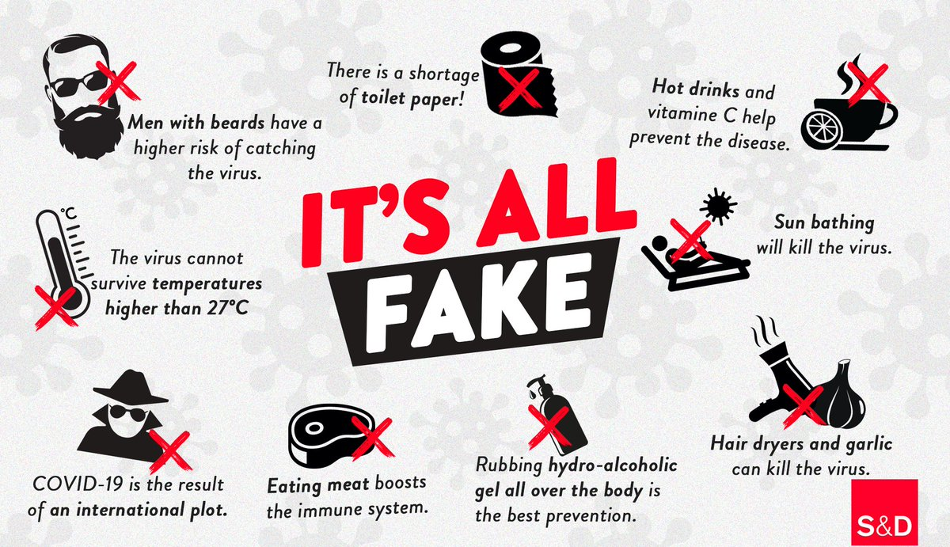

Slide 17
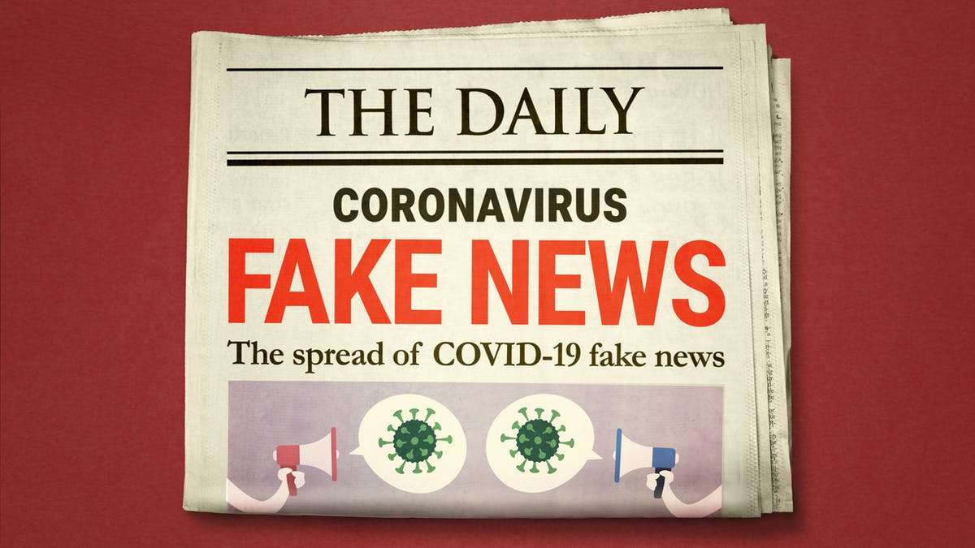
Proportion of fake news-Misinformation
This system failed to prevent COVID-19 misinformation from spreading as well as took down other valuable information and links to articles.
Many platforms struggled to moderate what was posted and shared in a timely manner before misinformation was spread. This was due to an increase in AI usage as many human moderators were sent home during shelter in place orders and faced contract restrictions and couldn't continue their work at home
YouTube has served as one of the major platforms to spread information concerning the control of COVID-19.
Therefore, videos, especially from public health authorities, should include accurate and reliable medical and scientific information and use relevant hashtags to reach a large audience, generate a high number of views, and increase responses.

Slide 18
Proportion of fake news-Misinformation
Comparing the proportion of fake news shared on WhatsApp, Instagram, and Facebook in Brazil showed that fake news was mainly shared on WhatsApp.
A UK study by Ahmed and colleagues analysed 22 785 tweets posted by 11 333 Twitter users with #FilmYourHospital to identify and evaluate the source of the conspiracy theory on Twitter.
Their work uncovered that ordinary people were the major driver behind the spread of conspiracy theories

Slide 19
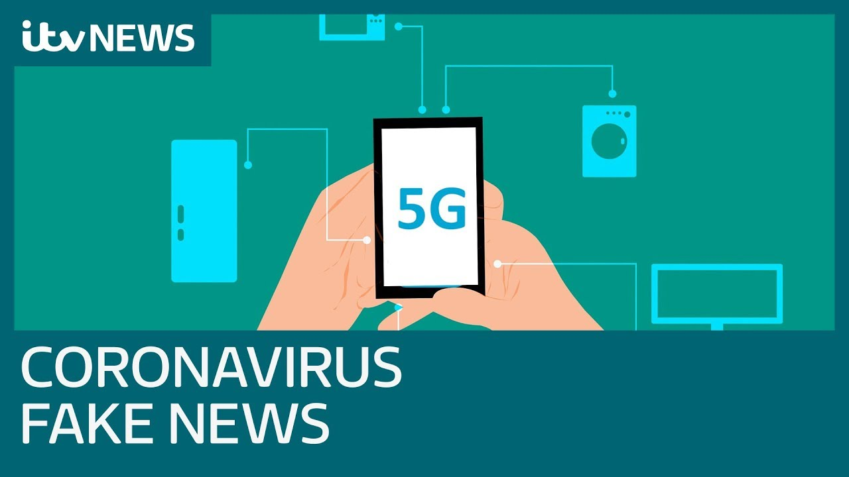
Proportion of fake news-Misinformation
5G and COVID-19
The conspiracy went viral after March 19, 2020, with unusual coalition among various groups on Facebook
Another study investigated the 5G and COVID-19 conspiracy theory that was circulating on Twitter with a random subsample of 233 tweets.
The content analysis showed that 34·8% (81) of tweets linked 5G and COVID-19 and 32·2% (75) condemned such theory
Misinformation was mainly driven by rumours, stigma, and conspiracy theories that were circulating on various social media and other online platforms.

Slide 20
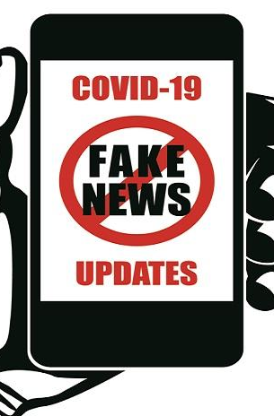
Proportion of fake news-Misinformation
5G and COVID-19
BBC News reported on Facebook, groups opposing vaccines and those campaigning against 5G mobile phone networks created unwanted rumours.
The Stop 5G UK group on Facebook 5G and other groups posted an article from Technocracy News that claims: "It is becoming pretty clear that the Hunan coronavirus is an engineered bio-weapon that was either purposely or accidentally released.
Misinformation and conspiracy theories regarding COVID-19 have been removed by Facebook and Instagram from their social media platforms.
Facebook has placed its focus on discouraging claims that include fake cures and methods of prevention.
Facebook's third-party fact-checkers work to limit the spread of false content by sending links to fact-checked information to the accounts who were attempting or who already shared the content in order to notify them and provide correct information.

Slide 21
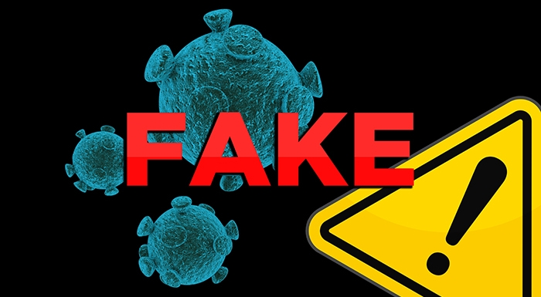
Proportion of fake news-Misinformation
BBC News reported on Facebook, groups opposing vaccines and those campaigning against 5G mobile phone networks created unwanted rumours.
The Stop 5G UK group on Facebook 5G and other groups posted an article from Technocracy News that claims: "It is becoming pretty clear that the Hunan coronavirus is an engineered bio-weapon that was either purposely or accidentally released.“
Online rumors have led to mob attacks in India and mass poisonings in Iran, with telecommunications engineers threatened and attacked and phone masts set on fire in the United Kingdom.

Slide 22
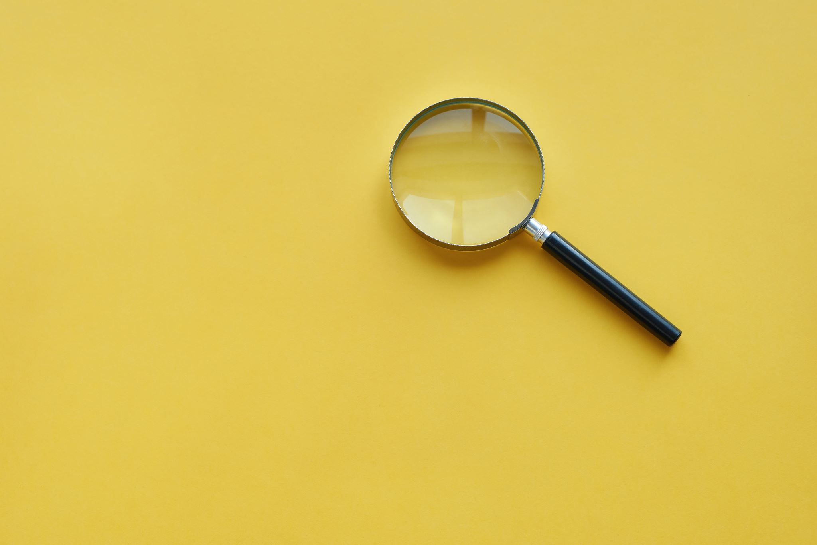
Reference Tsao, S.F., Chen, H., Tisseverasinghe, T., Yang, Y., Li, L. and Butt, Z.A., 2021. What social media told about us in the time of COVID-19: a scoping review. arXiv preprint arXiv:2101.01688. DOI:https://doi.org/10.1016/S2589-7500(20)30315-0 Smith, A., 2021. Facebook and Instagram to Limit Coronavirus Misinformation. [online] Entrepreneur. Available at: <https://www.entrepreneur.com/article/345770> [Accessed 7 March 2021]. Llewellyn, S., 2020. Covid-19: how to be careful with trust and expertise on social media. BMJ, 368. Zarocostas, J., 2020. How to fight an infodemic. The lancet, 395(10225), p.676. BBC News. 2021. Coronavirus: Fake news is spreading fast. [online] Available at: <https://www.bbc.co.uk/news/technology-51646309> [Accessed 7 March 2021].

